Slide 1

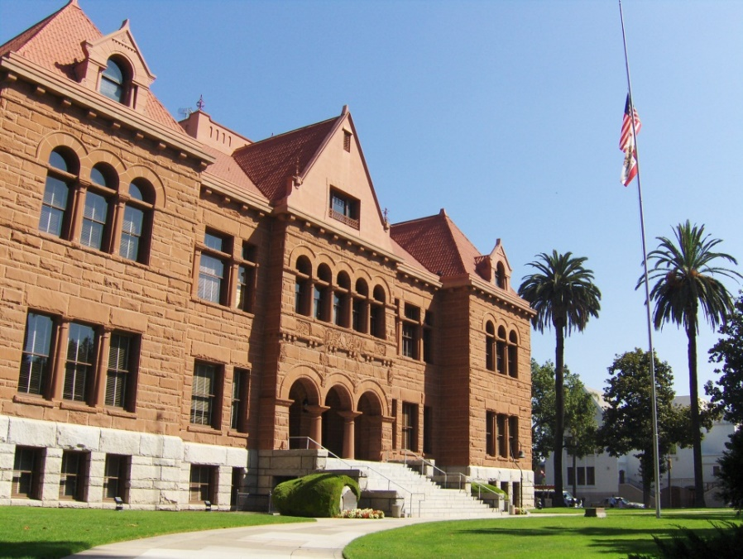

Assessment Appeals Overview
How to Prepare For A Hearing
Presented by
Orange County
Clerk of the Board
Of Supervisors

Slide 2
Presentation Overview
Confirming your attendance
Property Tax Event Timeline
Informal Review
Organizational Structure
Evidence/Comparable Sales
90 Day Rule

Slide 3
Presentation Overview
The Process
Withdrawing an Appeal
Rescheduling an Appeal
Waiver Agreement
Findings of Fact
Prop 13 value vs Annual value

Slide 4
General Overview of the Assessment Appeals Semi-Judicial process
Taxpayer submits appeal to the Clerk of the Board (COB) during filing period.
Clerk reviews application for completeness and timeliness and forwards information to Assessor’s Office.
COB schedules application for Hearing and notifies Taxpayer and Assessor staff.
Board reviews evidence presented at the hearing and makes a decision.
COB forwards decision to Assessor, Auditor, and Taxpayer.

Slide 5
Organizational Structure & Appointment Process
Orange County
Board of Supervisors
Assessment Appeals
Board
County Assessor
Taxpayer
Clerk of the Board
Auditor-Controller
Tax Collector
Notes:
5
BOS is County’s Board of Equalization
Appoints members to 5 boards and 5 hearing officer positions
Quazi-judicial Hearings, Board sits as a judge
Assessor and Taxpayer present evidence under oath
COB provides staff support
Aud-Cont. calculates tax due or refund
Tax Coll. Collects tax

Slide 6


What is an Assessment Appeal?
  The process to challenge the Assessor’s opinion of your property value.
  Timely, factual evidence
  * Must pay property
  taxes while appeal
  is pending
  Adjudicated before an
  Assessment Appeals Board

Slide 7
Should you file an Assessment Appeal?
Review
Review Property Value Notice
The value of your property as determined by the County Assessor.
Date
Evaluation Date
As of January 1 of each year (referred to as the lien date), the Assessor, if warranted, reviews the value of your property to ensure that it is at “taxable market value” or “proposition 13 compounded value” and makes any necessary adjustments.
Do Not Appeal
Appeal
Do not appeal your Property Value
If the assessed value is equal or less than what your property would easily sell for on the evaluation date.
Appeal your Property Value
If you feel that the assessed value of your property exceeds the market value of your property, you have the right to appeal the assessment.

Slide 8

Alternatives to an Appeal
Call (714) 834-2727 or write Assessor and ask for an Informal Review.
Request an informal review from January 1 through April 30 of each year.
Request an “Informal Review” by the County Assessor

Slide 9
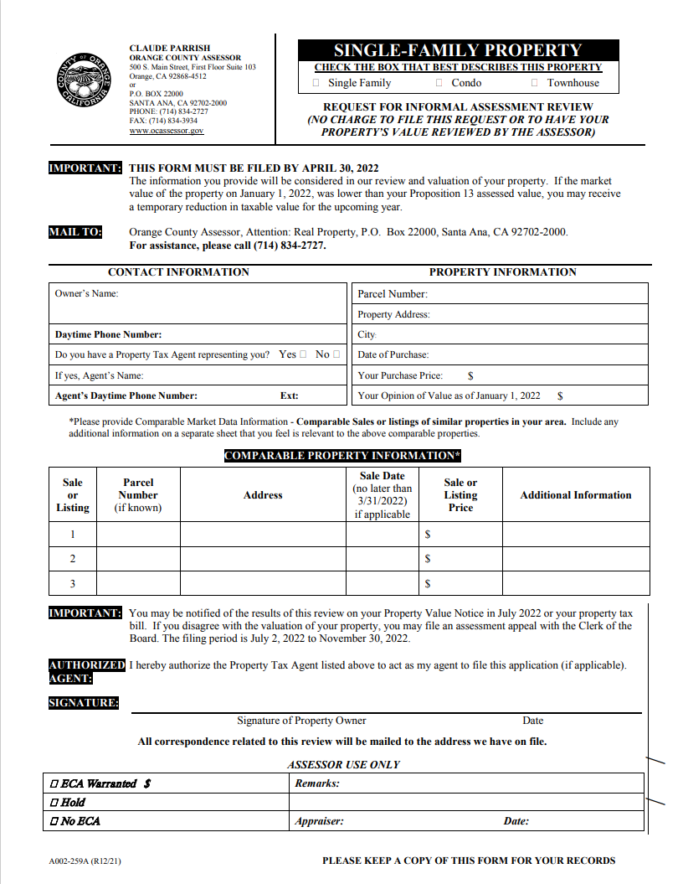
Request for Informal Review Form
Download the form from the Assessor’s website
http://ocgov.com/gov/assessor/forms

Slide 10
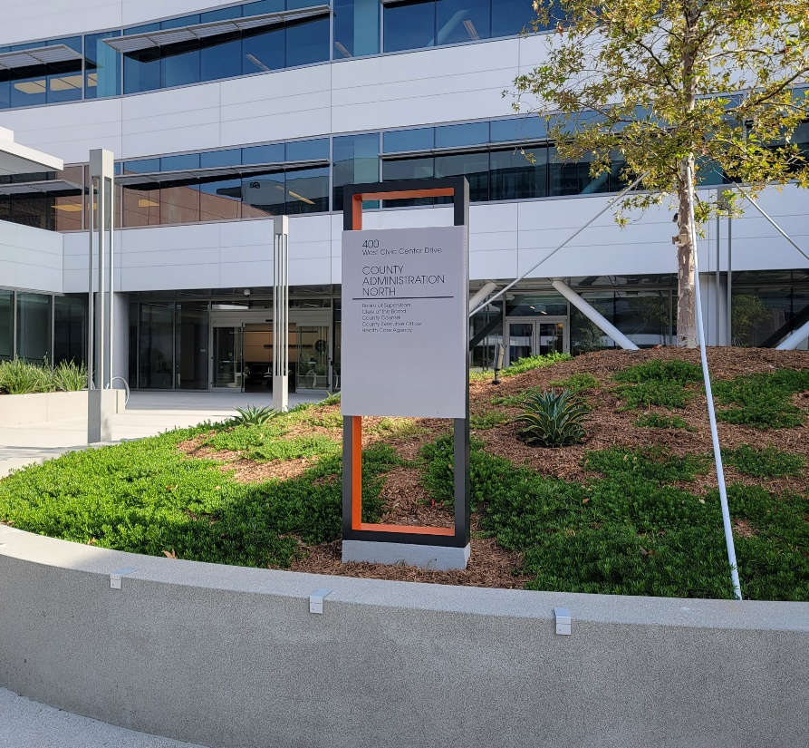
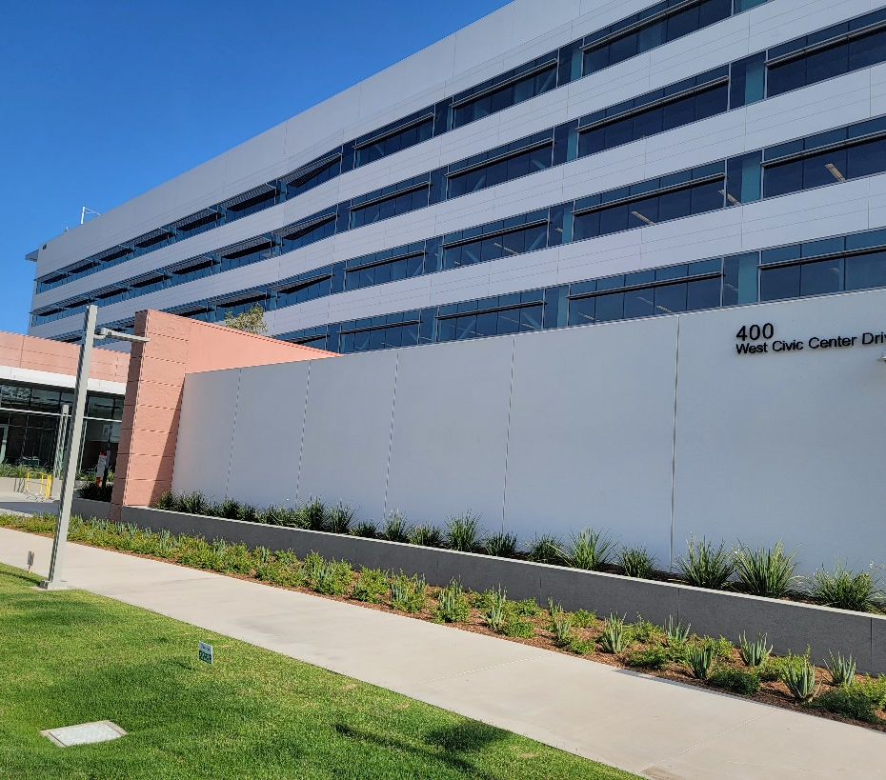
Assessment Appeals office
400 W. Civic Center Dr
First Floor, Room 103
Santa Ana CA 92701
714-834-2331 Ext 1
Response@ocgov.com
Notes:
Board 3 located inside this building.

Slide 11
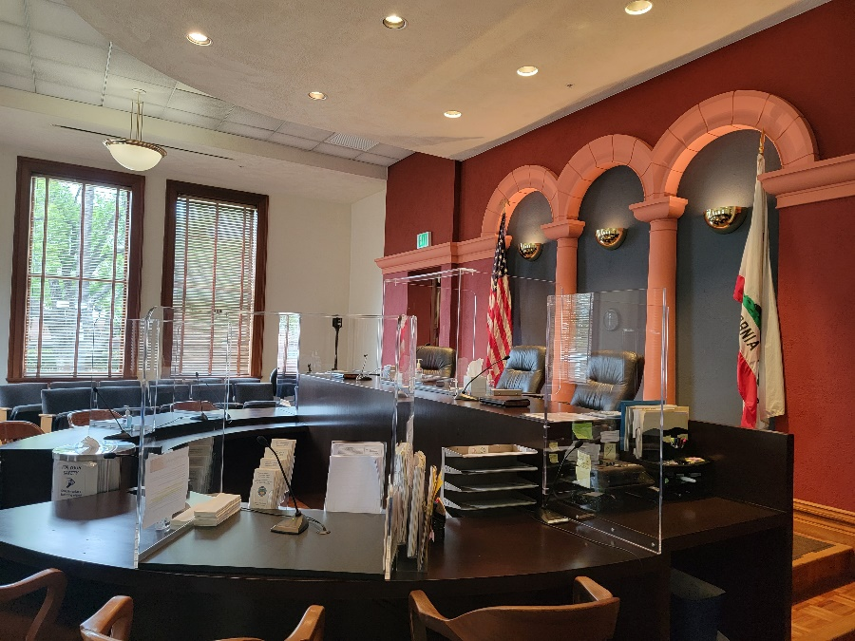
Hearing Location
Old County Courthouse
211 W. Santa Ana Blvd Room 207/208
Santa Ana CA 92701
714-834-3457
Judicial Support Unit

Slide 12
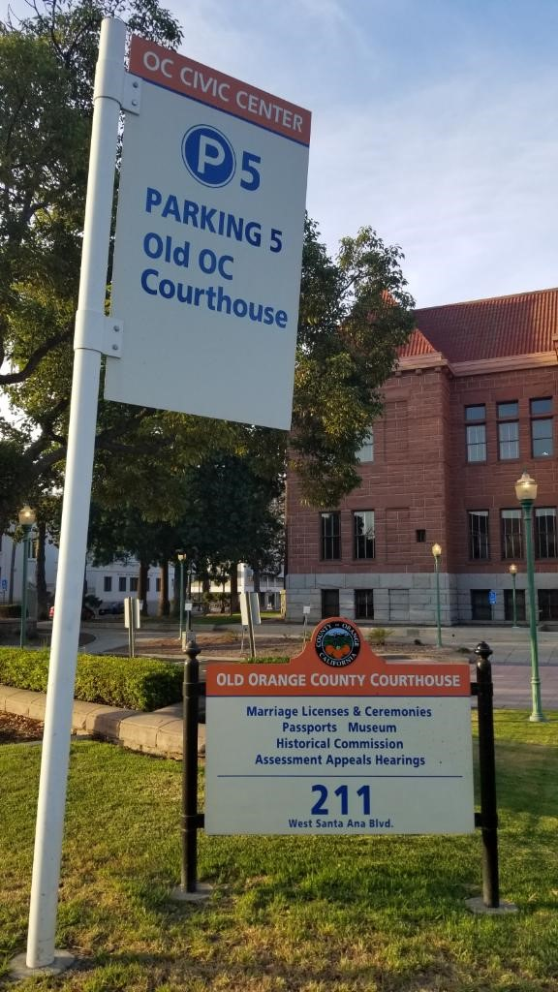
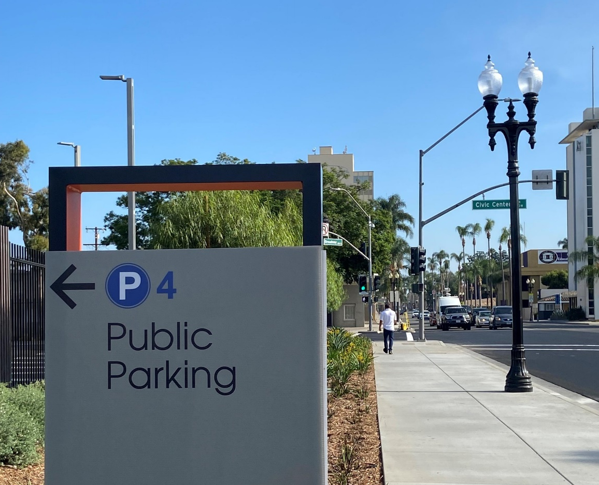
Parking
Parking lot P4 located at Broadway and Civic Center
Limited metered parking in P5 behind Old Courthouse

Slide 13
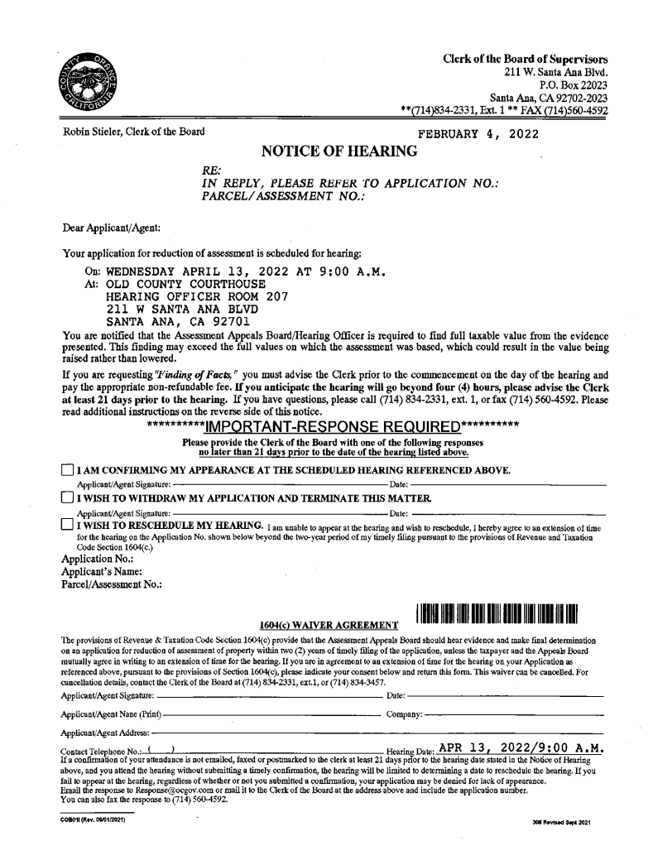
Confirming your hearing attendance
Confirm your attendance at least 21 days prior to hearing.
Mark the Confirmation of Attendance box on your Notice of Hearing, sign, and date.
Email to Response@ocgov.com or Fax to 714-560-4592 or mail to Clerk of the Board PO Box 22023 Santa Ana CA 92702.

Slide 14
Contact County Assessor
After you confirm your attendance, call the Assessor’s office to begin a discussion with the Appraiser handling your Appeal to possibly arrive at a STIPULATION of value.
Call the Assessor’s Office at (714) 834-2727
Ask to speak with an Appraiser in the Assessor’s Appeal Division

Slide 15
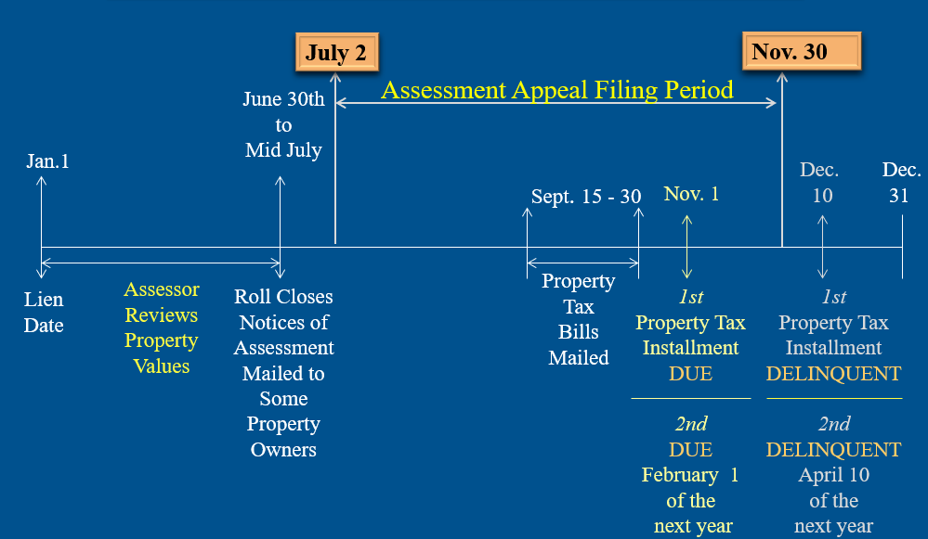
Timeline of Property Tax Events

Slide 16
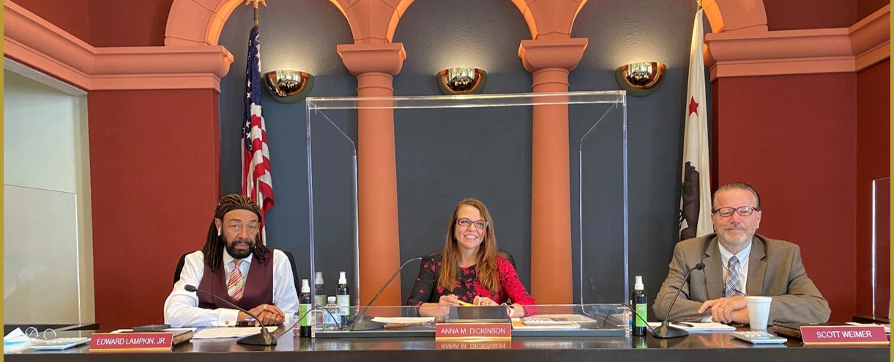
Licensed or Certified for a period of 5 years in California as:
  Appraiser
  Attorney
  Real Estate Broker
  CPA or Public Accountant
Assessment Appeals Board Members

Slide 17
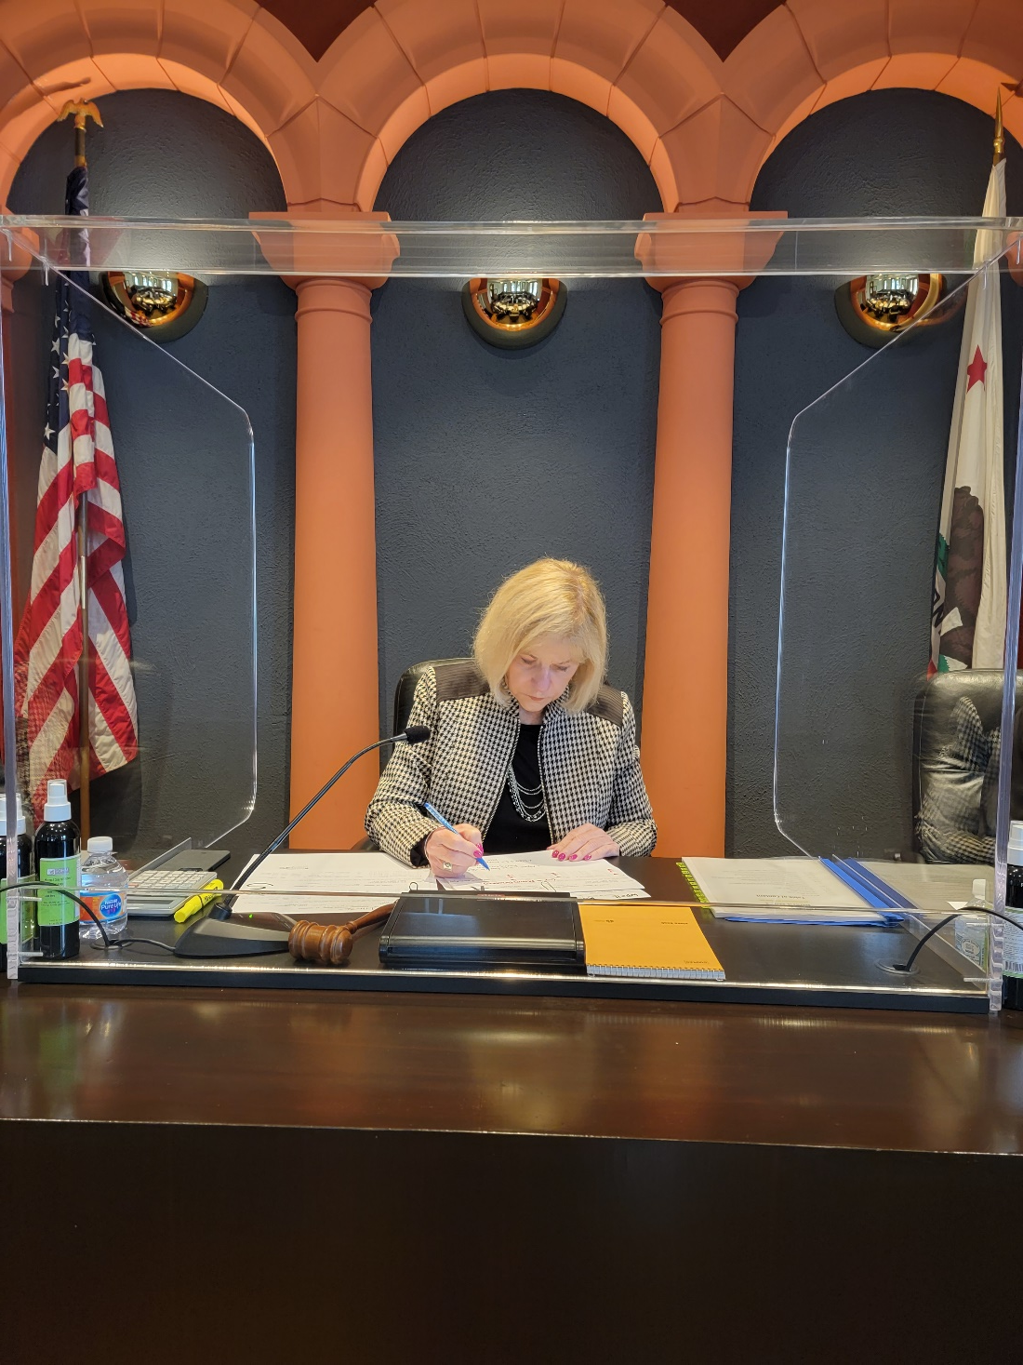
Hearing Officer vs
3 Member Board
A Hearing officer is one Board Member
A less formal setting
Cannot request Findings of Fact
Hearing Officer decision is final (Cannot go to a Board to appeal Hearing Officer’s decision)
An Assessment Appeals Board is a panel of three Board Members

Slide 18
What do I need as evidence?
Evidence
Three (3) comparable sales
Similar to subject property
Must meet the 90 Day Rule

Slide 19

What kind of evidence should I bring to the Hearing?
Timely, Factual Evidence
Comparable closed sales ONLY! No listings.
Copies to bring to the Hearing:
Hearing Officer- 4 copies or Board- 6 copies

Slide 20
Where do I get Comparable Sales for evidence?
Local real estate agents, appraisers, and title companies can assist you.
Online at Redfin or Zillow
For a $10.00 fee the Assessors’ office can provide current sales.
Notes:
Note: Assessors’ comps not as current as Realtor’s MLS data

Slide 21

Collecting comparable information factors to consider
Quality
Use
Age
Location
Condition
Amenities
Size

Slide 22
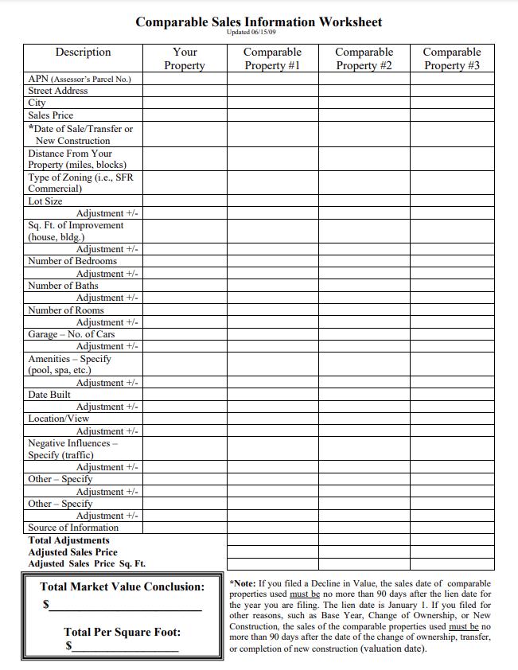
Comparable Sales Worksheet
Download form from our website
www.cob.ocgov.com/forms

Slide 23
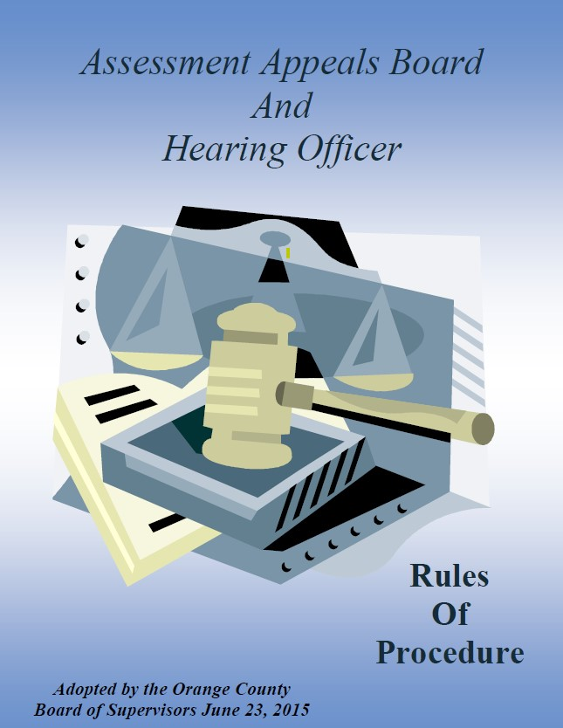
Review AA Board Rules
https://cob.ocgov.com/sites/cob/files/import/data/files/41239.pdf

Slide 24
90 Day Rule Regular Filing

Slide 25

90 Day Rule
Supplemental, Escape or Calamity

Slide 26

Collecting evidence and the 90-day Rule
Remember there are NO RESTRICTIONS on how far BACK in time you can go. Be sure to make appropriate monetary adjustments for market conditions.
Notes:
RESTRICTIONS only apply to how many days FORWARD in time your evidence can be from.
Decline in value- effective date Jan 1 of the year appeal filed or completion date of new construction or close of escrow date-90 days.

Slide 27
The Process
What to expect
Be on time for roll call.
Be prepared with proper evidence & copies.
Testimony will be under oath.
Plan to spend several hours at your hearing.

Slide 28
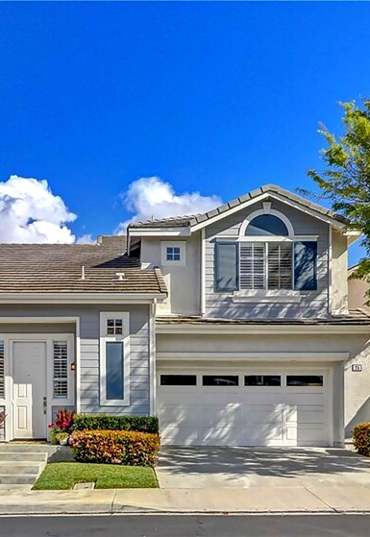
Can I change my opinion of value?
Yes.
The Board will make a determination of value based upon the evidence.

Slide 29
Can I withdraw my appeal?
Yes.
Send our office a written request to withdraw the application.
Or sign, date, and return the request to withdraw located on your hearing notice.
Or obtain form at www.cob.ocgov.com/forms.

Slide 30
Withdraw Request
Check box, sign, and date.
Return by Fax 714-560-4592
Email to
response@ocgov.com
Or mail to the address at top right corner.

Slide 31
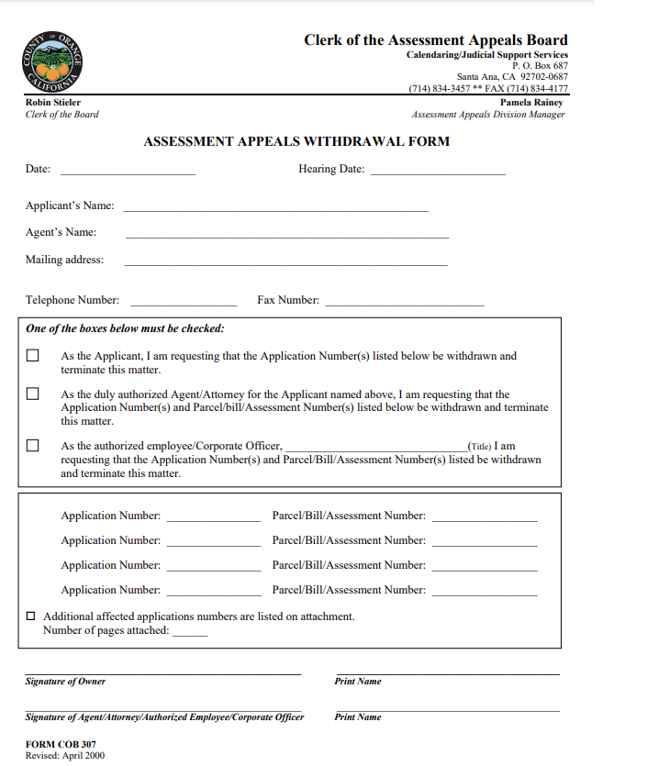
Withdrawal Form
Complete the top portion
Check one of the boxes
Insert Application Number and Parcel Number
Sign and Date

Slide 32
What if I can’t make the scheduled Hearing date?
You can reschedule your hearing
Complete and return the 1604(c) Waiver Form located at the bottom of your Hearing Notice.
Or download the form
Cob.ocgov.com/forms
The form must be returned prior to 10 days of your scheduled Hearing.

Slide 33
1604 (c) Waiver Agreement on Notice of Hearing
Check box.
Complete the bottom portion.
Return by Fax 714-560-4592
Email to response@ocgov.com
Or mail to the address at top right corner.

Slide 34
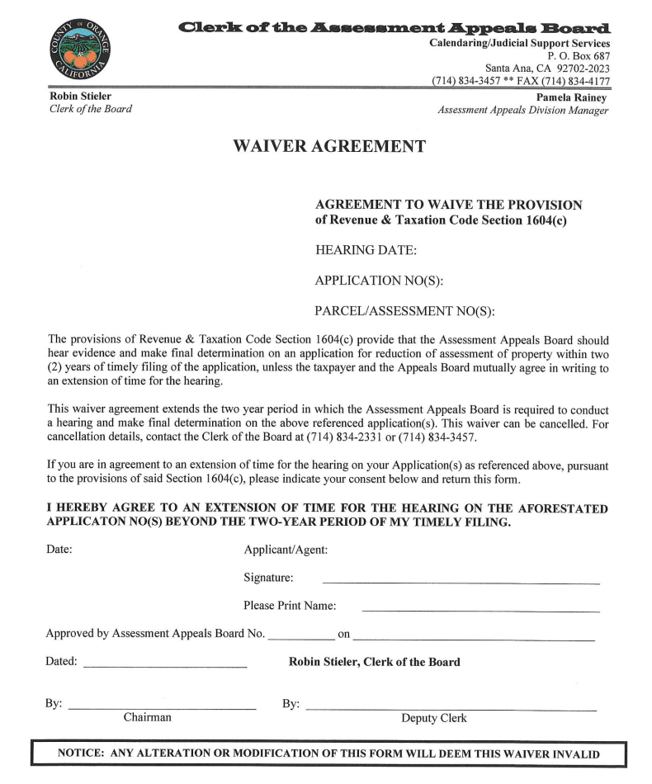
Waiver Agreement form on our website.
www.cob.ocgov.com/forms
Notes:
Complete sign, date, and mail, fax, or email.

Slide 35
Answer:
If you fail to appear at your hearing, your application will be Denied.
Question:
What happens if I don’t attend my hearing?

Slide 36
Question:
If I win, what happens?
Answer:
You will receive a refund of overpayment of taxes with interest from the Auditor-Controller approximately 8 weeks after your hearing.

Slide 37

If I don’t agree with the decision, can I appeal or have the appeal heard again?
The decision of the Board is final
The Board cannot reconsider their decision
It is appealable to Superior Court only

Slide 38
What are Findings of Fact?
A legal document that summarizes the grounds for appeal raised in your application, sets forth the Board’s evaluation of those issues and arguments, and shows the basis for the Board’s decision on your appeal.
Necessary only if you intend to challenge the Board’s decision in Superior Court.
Cannot be requested if using a Hearing Officer.
Must be paid prior to commencement of the hearing. The current fee is posted on our website
www.cob.ocgov.com/appeal-your-property-value/findings-facts-composite-rate
Notes:
The FOF rate is established using the County Wide Cost Allocation Plan , which is approved by the CA State Controller. Visit their site for more information.

Slide 39

Can I email or fax documents?
Yes!
Except for Appeal Applications/Corrected Applications
Email
Response@ocgov.com
Fax Number
714-560-4592

Slide 40
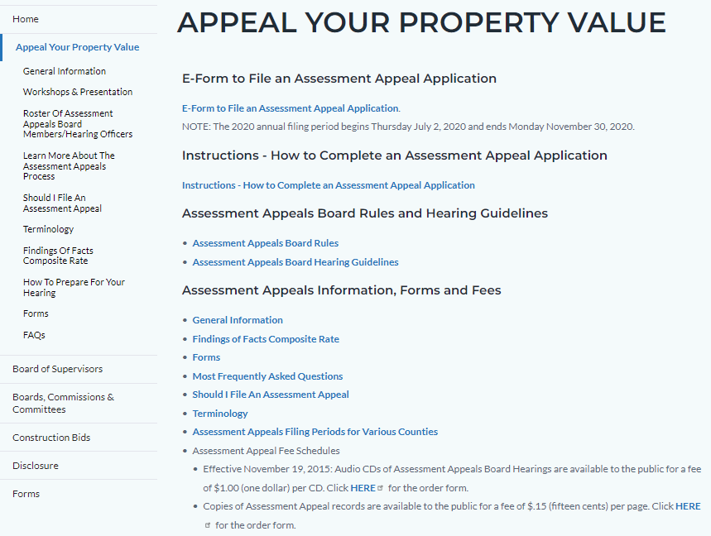
https://cob.ocgov.com/appeal-your-property-value
Visit our website for forms, AAB Rules, Hearing guidelines, related links, and other helpful information.

Slide 41
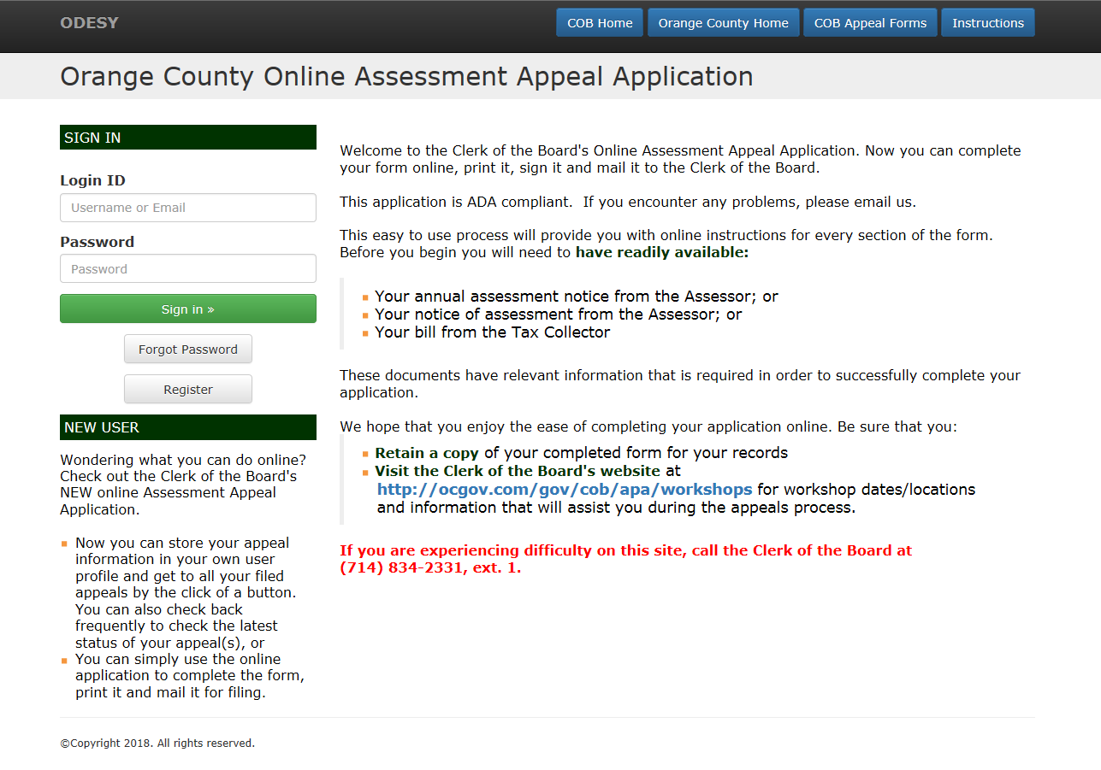

Assessment Appeal online application
www.assessmentappeals.ocgov.com

Slide 42
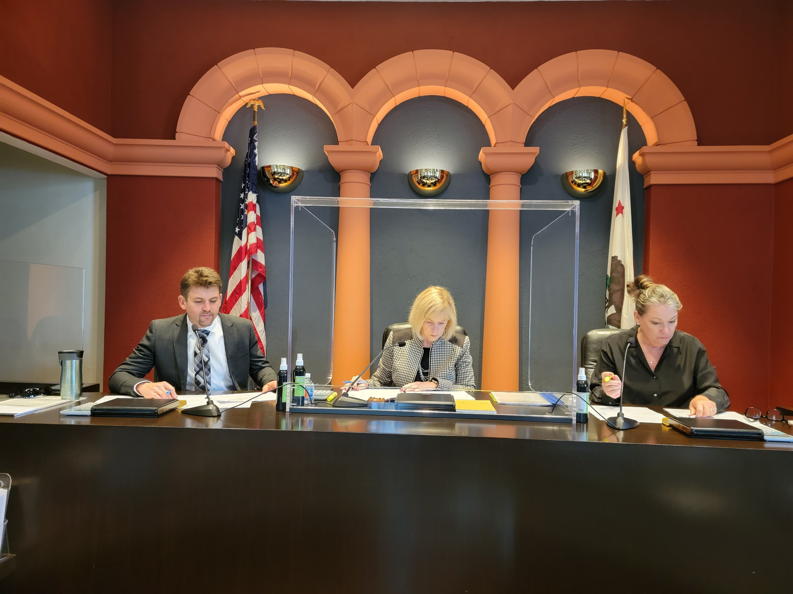
Can the Assessment Appeals Board raise my value?

Slide 43

After hearing all the evidence, an appeals board is required by law to determine the value of your property, which means that they can leave the value the same, decrease the value, or increase the value of your property. An appeals board is not bound by the value presented by you or the county assessor.

Slide 44
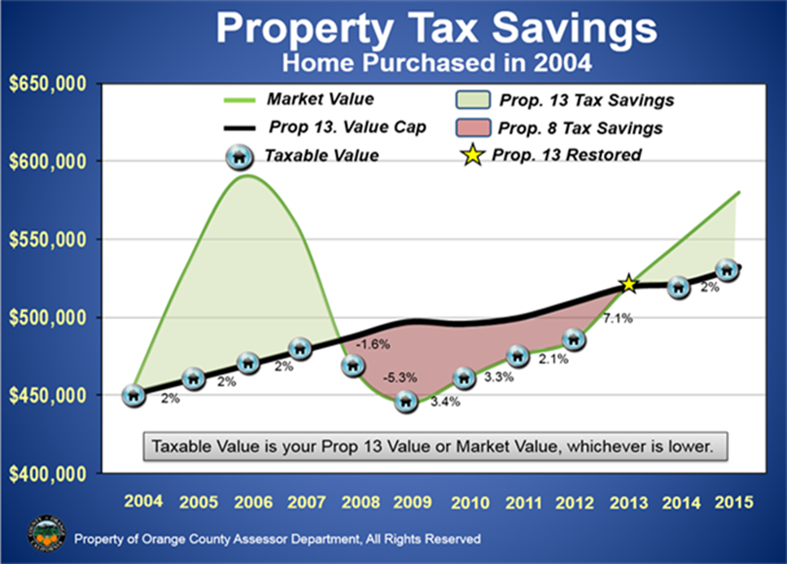
If the market values dips below the Prop 13 values then regain values as in the early 1990s, values can return to indexed Prop 13 value and can do so at a greater rate than 2%.

Slide 45
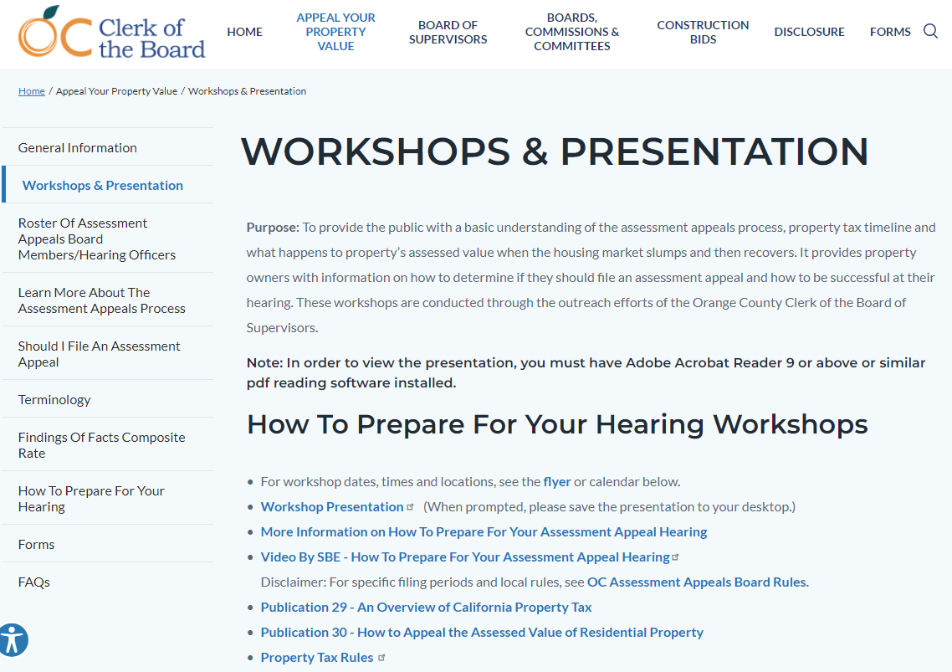
Obtain a copy of this presentation at:
https://cob.ocgov.com/appeal-your-property-value/workshops-presentation

Slide 46
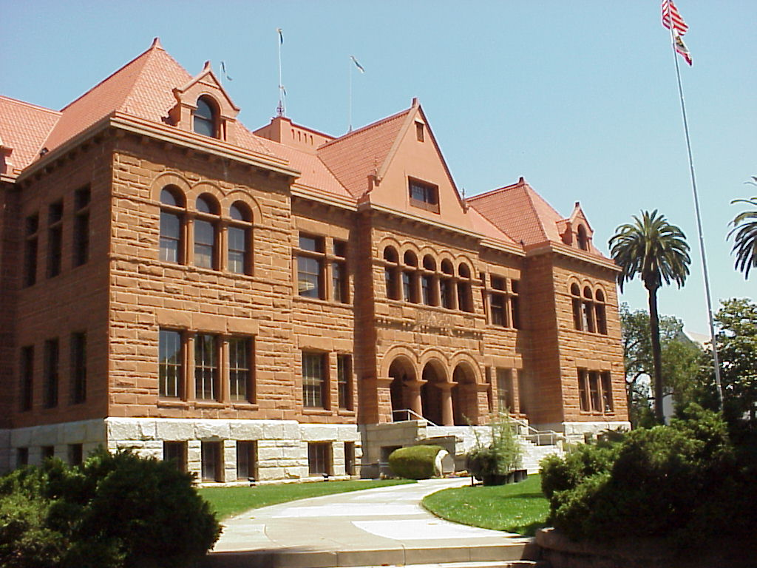
Thanks for attending!
Questions?
Comments?

